Slide 1
Planning, productivity, and career development
Annie Montemayor, M.A.
Career Counselor, Capella University | MCDA Board Member

Slide 2
Learning objectives
By the end of tonight, you’ll know:
How to create and implement a bullet journal
Why thoughtful and effective planning is an integral part of career development (both for ourselves and our clients)
How we can better support our under-resourced clients in their challenges with planning, scheduling, and prioritization

Slide 3
Will a Bullet Journal change my life and solve all my problems?
“…A planner won’t organize your life. You organize your life with the help of a planner. It doesn’t matter how fancy the cover or how many tabs or how much useful information is crammed into the margins; those things can’t organize your life for you…A planner is not your battle plan, it is the blank space where you write your battle plan.”
-Kelly Mantoan, This Ain’t the Lyceum blog
Notes:
Broader discussion about what we mean by “planning.” It goes deeper than just a to-do list, we are talking about time management, productivity, managing procrastination and a lot more. The bullet journal is a tool, but a lot of what we’ll talk about includes strategies that you implement in tandem with your bullet journal.
Who uses a planning system right now? What is it? Is it working for you?
What are your burning questions around this issue? What did you come here to learn tonight?
Do you see issues/challenges with you clients that you think more effective planning strategies could help with?
I wanted to be thoughtful about how I structured our conversation tonight because there are folks who really want to know about bullet journals, but I also think there’s a great conversation to be had about how planning in general intersects with career development and success and our role in helping under-resourced clients who have some unique challenges around this.

Slide 4
What do we mean by under-resourced?
Becker, K., Krodel, K., & Tucker, B. (2009). Understanding and engaging under-resourced college students : a fresh look at economic class and its influence on teaching and learning in higher education . Highland, TX: aha! Process, Inc.
Internal resources | External resources
Knowledge of hidden rules | Language
Mental/cognitive | Relationships/role models
Emotional | Support systems
Motivation/persistence | Financial
Integrity/trust
Physical
Spiritual
Becker, K., Krodel, K., & Tucker, B. (2009). Understanding and engaging under-resourced college students: A fresh look at economic class and its influence on teaching and learning in higher education . Highland, TX: Aha! Process, Inc.
Notes:
Understanding and Engaging Under-Resourced College Students and focuses on economic class which is becoming a bigger part of conversations around inclusion and equity, but still under-represented at times.

Slide 5
What do we mean by under-resourced?
Internal resources | External resources
Knowledge of hidden rules | Language
Mental/cognitive | Relationships/role models
Emotional | Support systems
Motivation/persistence | Financial
Integrity/trust
Physical
Spiritual
Becker, K., Krodel, K., & Tucker, B. (2009). Understanding and engaging under-resourced college students: A fresh look at economic class and its influence on teaching and learning in higher education . Highland, TX: Aha! Process, Inc.
Notes:
In regard to this conversation, these five may be most relevant, recognizing that there are a lot of intersections between these resources that can affect others
Does anyone have examples how these manifest for clients?
So some people may feel like teaching planning strategies is outside the realm of student development, but the reality is that these are indeed career readiness skills. If our clients enter the workforce unable to manage their tasks, keep track of responsibilities, plan long-term, they’re going to have trouble and that’s why this is an issue of equity. If we’re serious about a more equitable workforce, a more equitable world, this is an issue to address and a skillset to build!

Slide 6
Bullet Journal supply list

Slide 9
Basic setup and terminology
Index
Future/yearly log
Monthly log
Weekly log
Daily log
Collections
Notes:
The concept of setting it up as you go

Slide 10
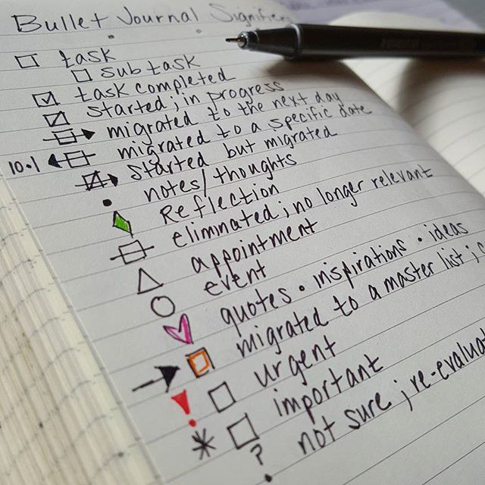
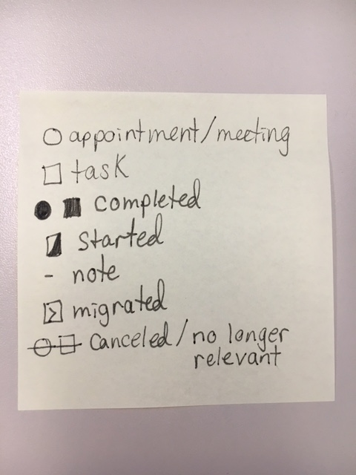
Symbols

Slide 11
Index
How to find everything!

Slide 12
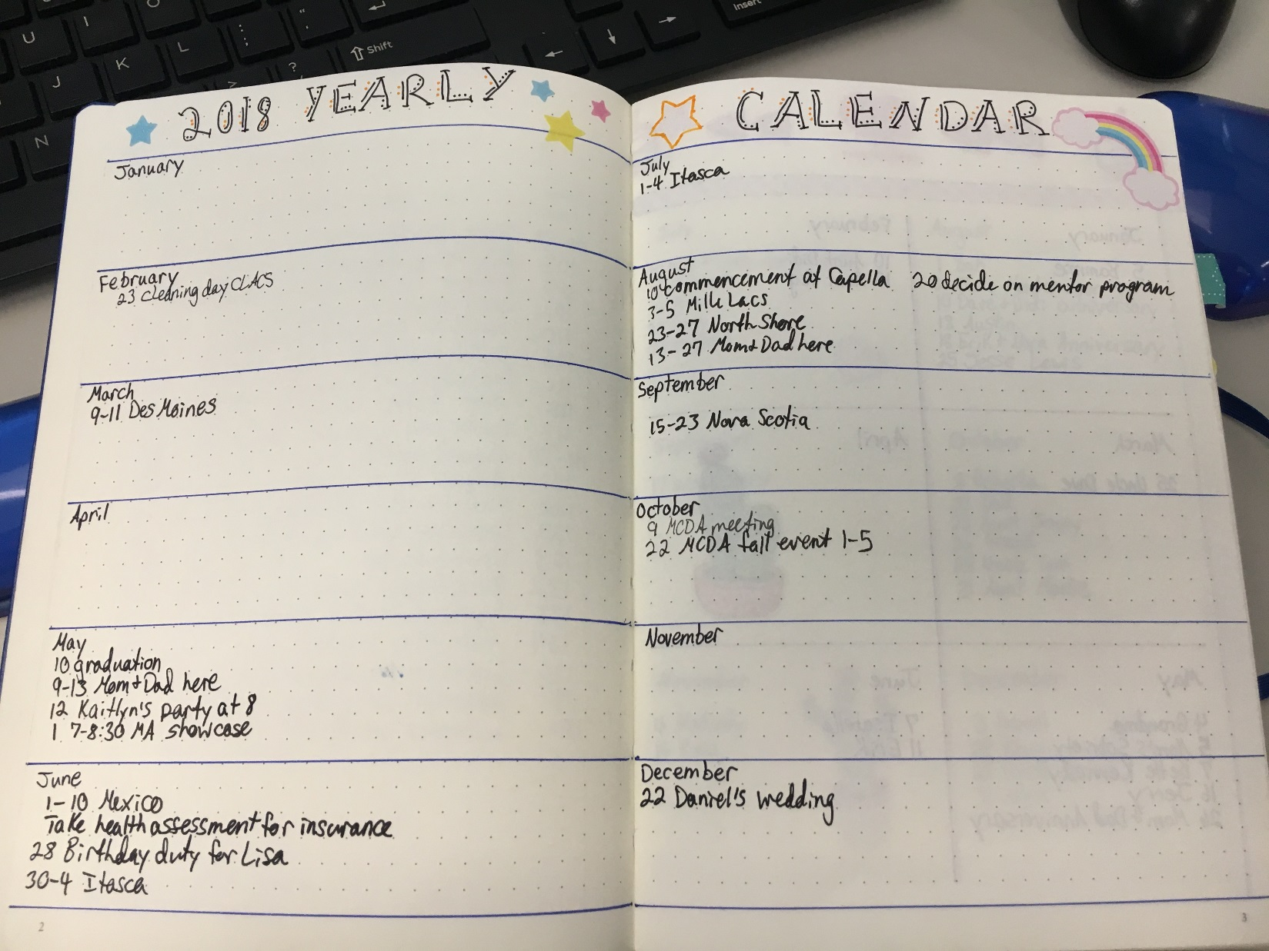
Future/yearly log
Keep track of vacations, conferences, weddings, etc.

Slide 13
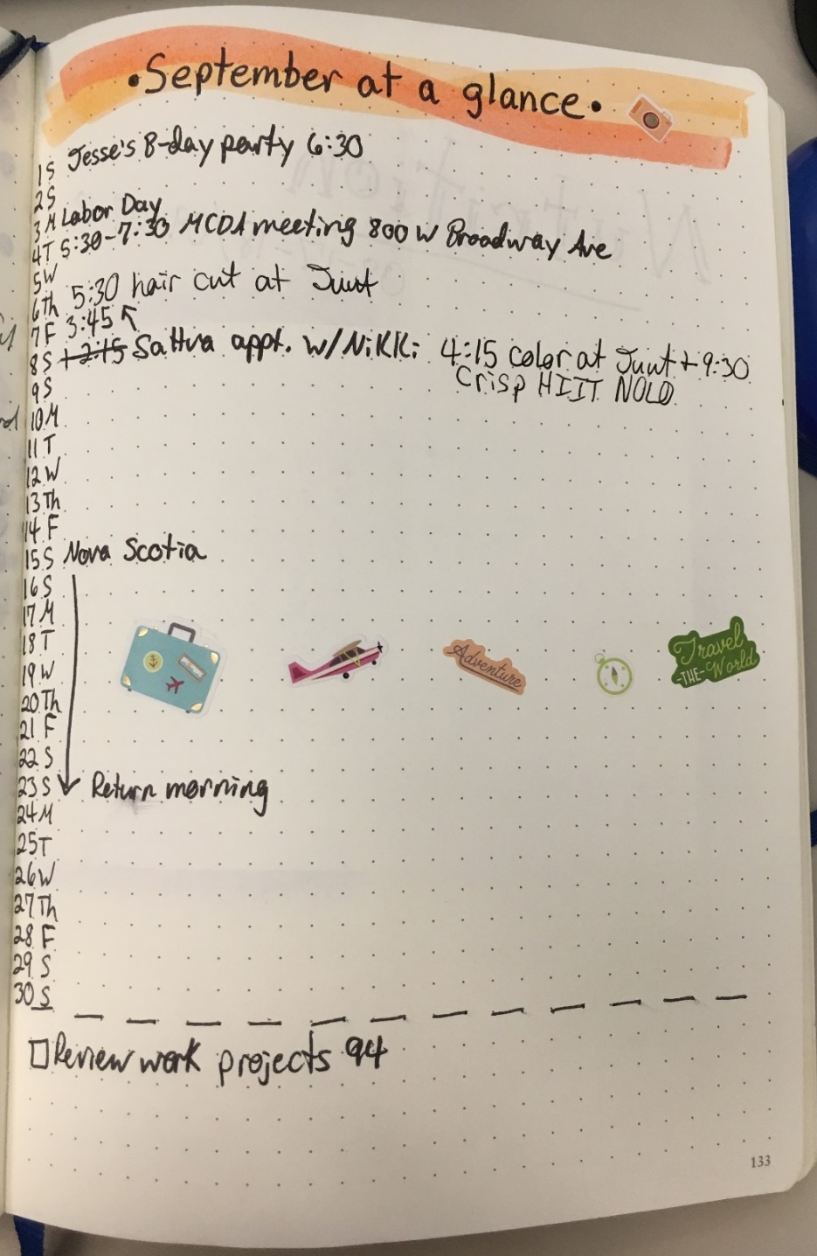
Monthly log
Pulled from your yearly log and later used to fill in weekly/daily log.

Slide 14
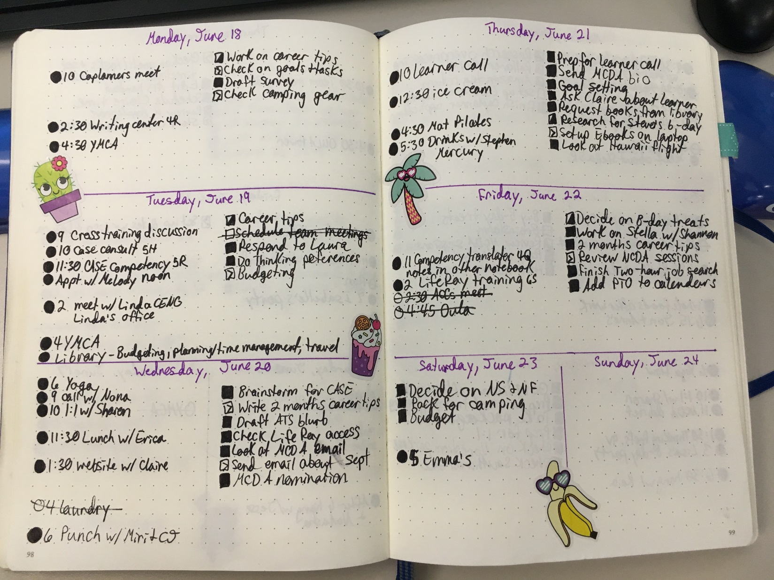
Weekly/daily log
What you’ll tackle imminently.

Slide 15
Collections
These pages are scattered throughout your BuJo and you can find them via the index
Anything you’d like to keep track of

Slide 16
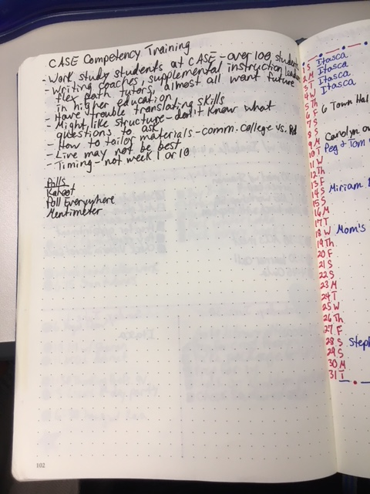
Collections
Meeting notes (later reviewed to develop new tasks/appointments)

Slide 17
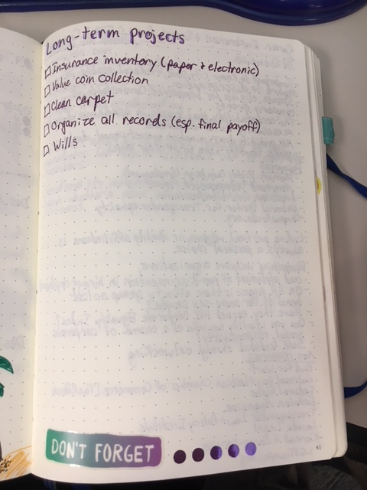
Collections
Long-term projects or goals

Slide 18
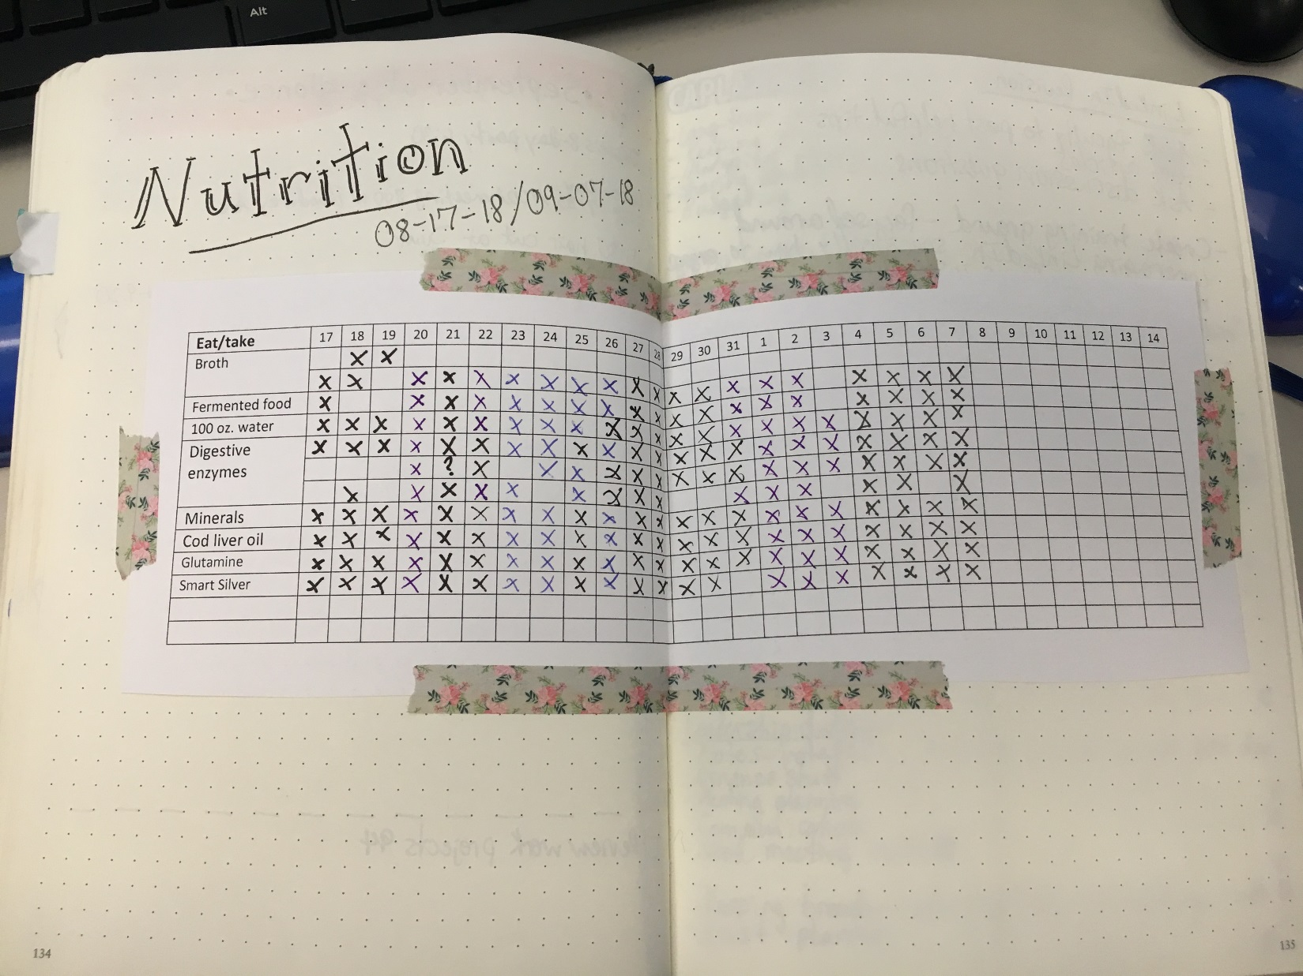
Collections
Trackers for exercise, nutrition, or anything else

Slide 19
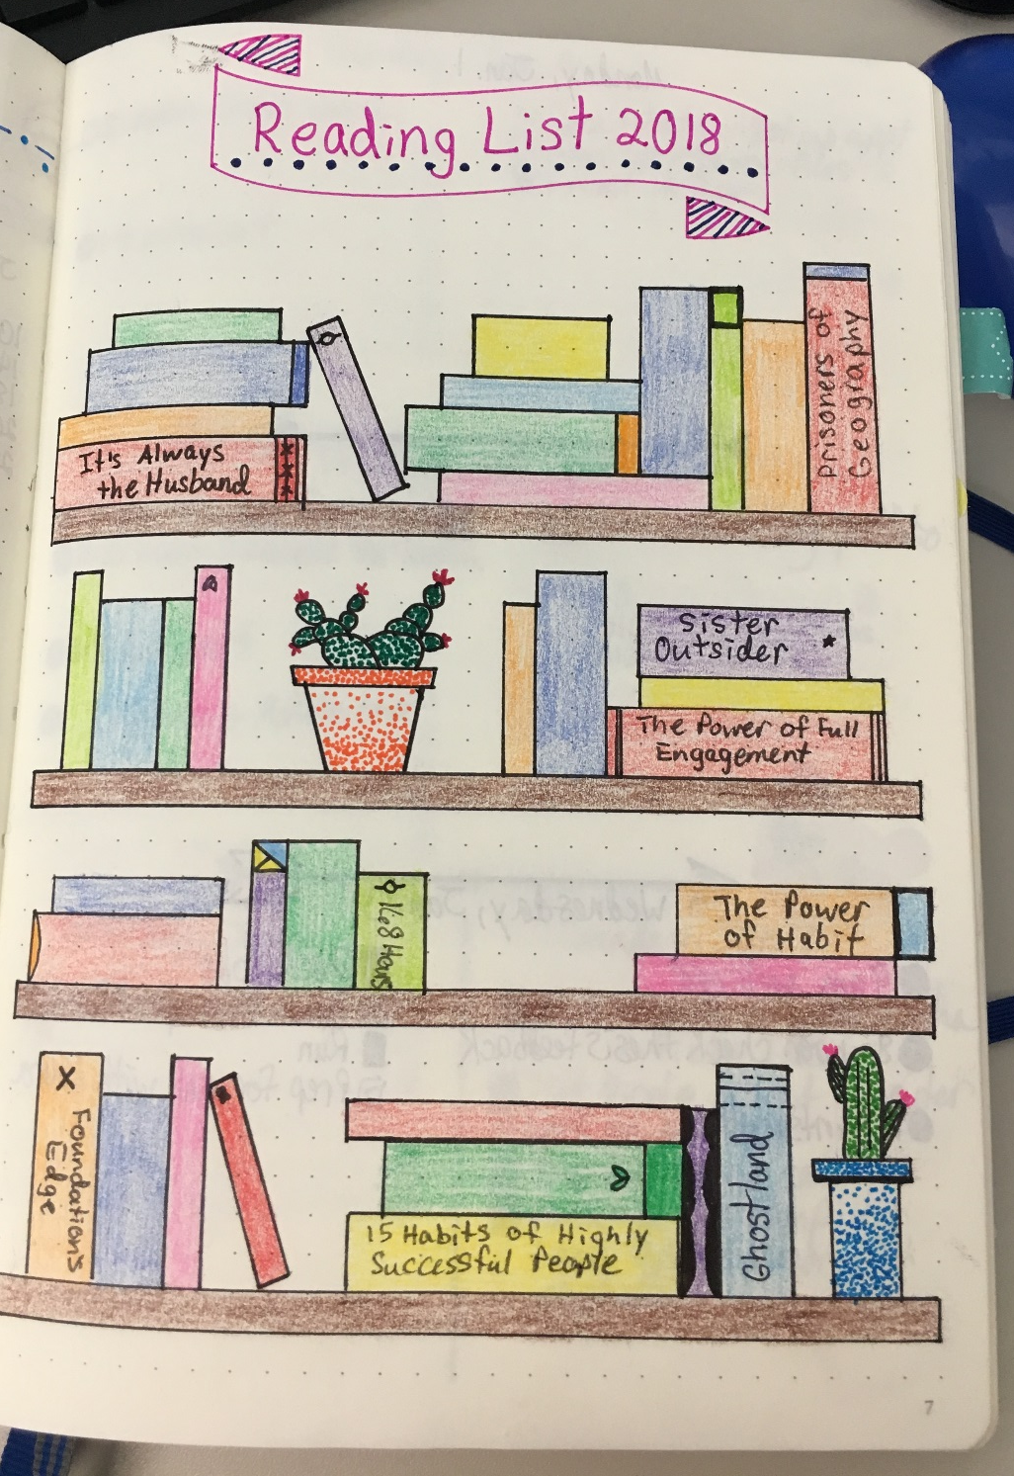
Collections
Books you’ve read or want to read

Slide 20
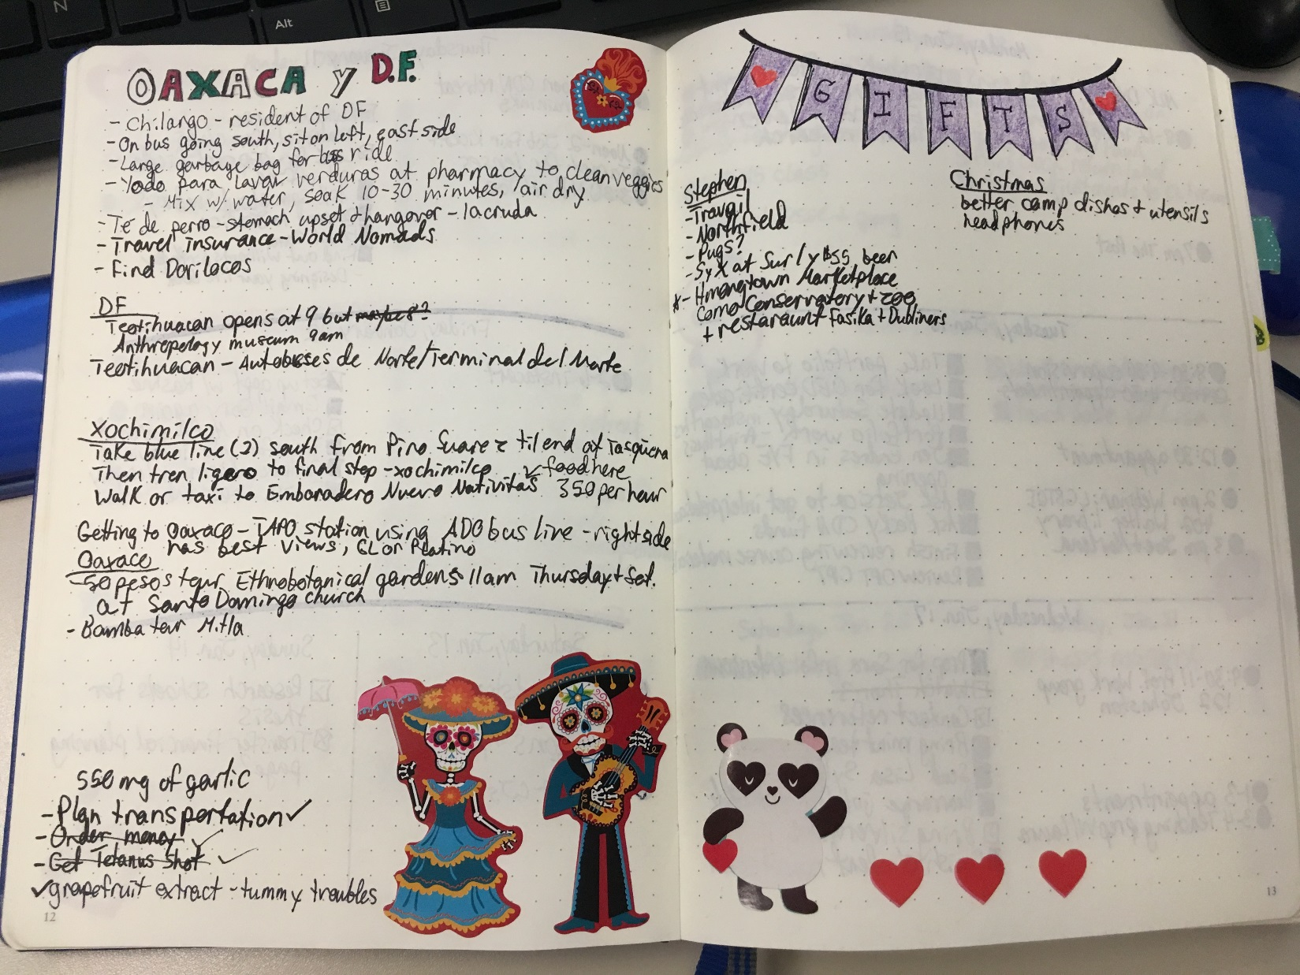
Collections
Travel plans or gift ideas

Slide 21
Pros of Bullet Journals
Cheap!
You get complete control over what’s included, how it’s set up, and how you use it. It can continually grow and change based on your needs.
Reduce stress: A portable notebook so you always have it with you when an idea or to-do crosses your mind.

Slide 22
Cons of Bullet Journals
Pressure of perfection. “I’m not artistic enough!”
Can seem time-consuming, particularly when starting out.

Slide 23
Questions so far?
Next…
How do we use this with clients?

Slide 24
Drilling down:
Write a term paper
Select a topic
Research the topic
Analyze Interests
…
…
Becker, K., Krodel, K., & Tucker, B. (2009). Understanding and engaging under-resourced college students : A fresh look at economic class and its influence on teaching and learning in higher education. Highland, TX: Aha! Process, Inc.

Slide 25
Step sheets
Steps | Amount of time required
1 Choose research topic | 1 hour
2 Collect 5 research articles | 2 hours
3 Outline paper | 1 hour
4 Write introduction | 30 minutes
5 …
Becker, K., Krodel, K., & Tucker, B. (2009). Understanding and engaging under-resourced college students: A fresh look at economic class and its influence on teaching and learning in higher education. Highland, TX: Aha! Process, Inc.

Slide 26
Example

Slide 27
Career Planning in a Bullet Journal
Bullet Journal for Career Planning

Slide 28
Additional resources
bulletjournal.com
Bullet Journaling for Beginners (and Impatient, Unartistic People Like Me)
Why You Procrastinate (It Has Nothing to Do With Self-Control)
Passion Planner
Bridges out of Poverty (Aha! Process)

