Slide 1
Workplace Bullying
Interview Findings, Implications & Tactics
Dean R. DeGroot, M.S., LP

Slide 2
Overview
Bullying at Work
  Definitions, facts, toxic environments
  Who are bullies & targets; costs, symptoms
Interview Findings & Implications
  Methods
  Data thus far
Successful Methods for Confronting Bullying
  Practices/research in field
  Tactics from my research
  Exercise

Slide 3
Bullying Facts
2003, 24% of surveyed companies reported some degree of bullying (NIOSH study)
Bullying victims: (2000 study: Workplace Bullying/Trauma)
  41% diagnosed with depression
  31% women, 21% men diagnosed with PTSD
2007 Study: 37% of American workforce has been bullied, or 54 M people (WBI)
Targets quit 40% of cases; 24% fired; 13% transfer
Bully is punished 23% of cases (WBI, 2007)
$26 B. annually of work-related disease/stress
Notes:
Between 1993 & 1999, 1.7 million incidents of workplace violence occurred annually in the US, with 12% of all victims reporting physical injuries (BLS, 2001)
PTSD: Iraq= 35%
77% of targets leave in some fashion
Exposure to bullying is like exposure to radiation—it leaves you vulnerable to various health issues and well being.

Slide 4

Demographics of Bullying
72 % are bosses
18 % are co-workers
10 % from lower ranks
More often male than female (60 to 40%)
Males equally bully men & women; women target other women more often (71%, WBI, 2007)
Narcisistic Personality or other MH issue
Often insecure all Crave control
    Opportunistic
    Substance-abusing
    Previously abused
Notes:
I’ve worked with all situations.

Slide 5
What is Workplace Bullying?
“Repeated, unreasonable actions of individuals (or a group) directed towards an employee (or a group of employees), which is intended to intimidate and creates a risk to the health and safety of the employee(s). It involves an on-going pattern of behavior.”
(Washington State Dept. of Labor & Industries, 2008)
(“Mobbing”: emotional abuse committed directly or indirectly by a group)
Notes:
Heard of mobbing before?

Slide 6
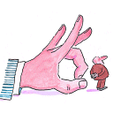
What Enables Bullying?
Bad management
Stress-intensive workplace
Disbelief or denial by Managers
Unethical activities
Downsizing, Restructuring, Mergers
Little or no HR support
Ineffective performance management practices
“toxic” protectors
New people in the picture
Target is often unsupported when they complain
Notes:
You’re job is not to be a punching bag for anyone!

Slide 7

Symptoms of Bullying
Stress/irritability/panic attacks/PTSD
Reduced concentration, increased emotionality
Illness/accidents
Social misery
Depression/isolation
Reduced productivity
Absenteeism/tardiness
Blood pressure/heart issues
Sleep difficulties
Change in personal and work relationships

Slide 8

Cost of Bullying
$5,000 to $100,000 per year for “employment practices liability” insurance (2008)
Reduced work quality & quantity
Factionalism
Increased employee turnover—stars leave!
Increased sick leave
Cost of consultants
Unemployment/worker’s compensation
Litigation/settlements
Reputation
Notes:
E.G.—highly compensated sales person cost the company $160,000 in one year: management time, executives, recruitment training of new employees, outside consultants, etc. They decided to deduct 60% of this cost from his year-end bonus.

Slide 9
Be a Target, not a Victim!
Target
Victim
Try new strategies
Reach out to others
Look for the reality
Take calculated risks
Believe bully is crazy
Find resources
Asserts boundaries
Stay wounded
Isolate self
Catastrophize
Lost in denial
Believe they are crazy
Give up
Has no boundaries

Slide 10
Interview Findings
Structured Interview began February 2011
  25 Targets (20 women; 5 men)
  4 EAP professionals
  Requested 30 minutes; typically got an hour
  Participants were helpful and often provided more information than requested
  Many participants described the experience as “cathartic” or “therapeutic”
  Most stated that they wanted the information to help others in some way

Slide 11

Demographics of Targets
Age when bullying began at work:
  Range (24 to 61 years old)
  72% between ages 41 & 61
Tenure with Organization:
  Range (less than 1 year to 31 years)
  Mean average: 6.5 years; median= 5.64 years
Were you ever bullied/abused as a child/teen?
  Yes: 60% No: 40%
  (Interview information: Dean DeGroot, 2011-12)

Slide 12
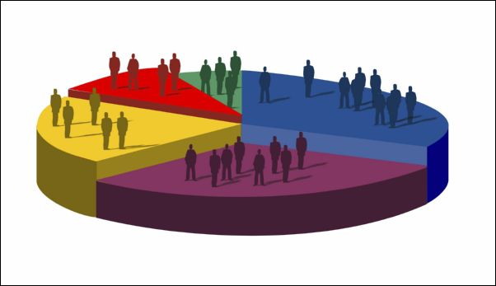
Demographics
# of Organizations bullied: one= 80%;
  Two= 12%; Three or more= 8%
Type of industries:
  Consulting firms—20%
  Technology company—12%
  Healthcare—12%
  Engineering-related—12%
  (Interview information: Dean DeGroot, 2011-12)
Notes:
Had various industries, from non-profit to financial sector, from small 5-person organizations to large corporations.

Slide 13
What did You Do About It?
Went to HR
Spoke to boss
Went to bosses boss/higher levels
Got a lawyer/went to legal department
Saw a counselor/therapist
Keep it all to myself
  (Interview information: Dean DeGroot, 2011-12)
Notes:
Often, the boss as the bully, but some folks tried to work things out. In some cases where the boss was not the bully, they went to the boss for support. In the former situation, the boss didn’t change or got worse or more nuanced in bullying. In the latter case, the boss sometimes supported the employee, but other times did nothing.

Slide 14
When Bullied, What should Happen?
Something specific is done to bully
  Performance evaluation
  Training
  Discipline/termination
  Counseling/therapy/mediation
More HR practices regarding bullying
  Define bullying
  Mechanisms for safe reporting of incidents
  Effective HR interventions & investigations
  Better involvement from company leaders
Target act quicker to help self
  Realization, documentation, get help/protect self
  (Interview information: Dean DeGroot, 2011-12)

Slide 15

How Survive Bullying?
Supportive colleagues
Focus 1 day at a time/grit/determination
Supportive friends
Supportive family
Strong work team
Look for/attain a different job
Faith/prayer
Counseling/therapy
Realize it’s time to go
  (Interview information: Dean DeGroot, 2011)

Slide 16
Implications
People in power need to be more aware of how they impact the lives of others and need to take greater responsibility for their actions and the kind of climate they shape
Bullying creates significant health risks to employees, both physically & psychologically
Bullying often ends with the target leaving; informal tactics don’t work—clear policies and training are required

Slide 17
What Career Counselors can do
Become more knowledgeable of PTSD and anxiety disorders
Coach candidates on several areas:
  Assessing & Identifying toxic environments
  Supporting targets to return to the work world with their dignity
  Providing resources on bullying to their clients
  Improving verbal & non-verbal communication skills and “political” skills

Slide 18

Assessing the Environment
Research organization—find out about reputation, turnover, philosophy, hiring practices, history of down-sizing.
LinkedIn: who can you talk to that can give you a sense of the organization
Business/Cultural Practices:
  Policies regarding nepotism
  Regular performance appraisal
  Respectful workplace values/anti-bullying
  Use of references—find subordinates to talk to.
Notes:
Make good use of your network to assess the environment; it’s important to use linked-in other sources to identify who you may be working with in the future.
Remember: majority of bullies are bosses/managers, so talk to subordinates, not just peers or superiors.
What else have you tried using/doing?

Slide 19

Enhancing the boss relationship
Know the “hot buttons” both by asking them and others; pursue good marks from those your boss respects
Clarify mutual expectations/goals immediately
What are their strengths/weaknesses?
How are problems typically handled?
What is their view of “success” and how is it celebrated?
Are you doing anything that could be viewed as a threat?
Recognize their accomplishments & yours.
Have regular contact and no surprises

Slide 20
Exercise
What could you do to avoid being targeted for bullying?
What “red flags” would you try to notice when “shopping” for a new job/organization?
Notes:
Split people into groups to do this and have groups report back.

Slide 21
What Works for the Organization
Coaching in combination with 360-degree feedback; better with an external consultant
Helping the team after the toxic source is gone
Organizational approach: mission and values that are people-friendly (“respectful engagement”)
Integrate values into the team—part of performance evaluation
Better hiring practices—”fit” & collaboration
Exit interviews
Sometimes:Termination
Training: zero tolerance for disrespect!
Notes:
What have you heard that works?

Slide 22
Namie BluePrint (“The bully-free Workplace”,2011)
Assess: Quantify & Qualify bullying
Create a Policy to Prevent Bullying
Develop Informal Solutions
Establish Formal Enforcement Procedures
Provide Restorative Justice
Deal with Confirmed Violators
Educate Employees on the BluePrint
Optimize Accountability
  Integrate into Performance Evaluations
  New Hiring Strategies (subordinate references)
  Modify Management Training (monitor & intervene)
Notes:
Have a “bully team”= cross-section of employees, different levels, to rotate being the group to go to for intervention. Also, could have someone on each team as the “advocate”; rotate these roles.

Slide 23

What works for Targeted Employee
Family/friend support
Educating oneself in bullying resources
Therapy/EAP
Good documentation
Sometimes, civil/legal action
Asserting their boundaries
Realizing they have options: stay, leave, other
Creating a Success Team
Human Right Departments (sometimes)
State business impact of bullying to org. (benefit)
Notes:
Ultimately, need to decide: stay, accept, change, or leave. What are you gaining in this situation? Sometimes, if team is cohesive, can chase the bully out.
Business impact will be viewed more legitimately by the organization than your own story of victimization. This will rally upper mgmt. and other stakeholders to take action.

Slide 24
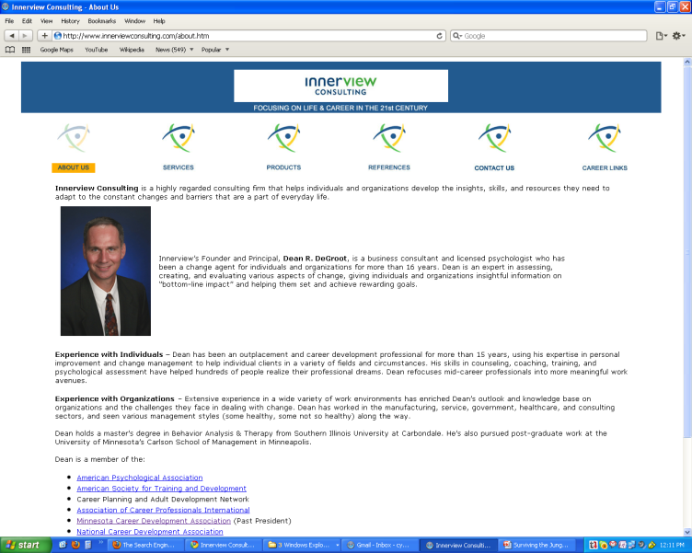
Contact Information
Dean R. DeGroot, Principal
Innerview Consulting
3232 Buchanan Street NE
Minneapolis, MN 55418
Phone: 612-789-9596
Cell: 612-702-5490
Fax: 612-789-9596
Email: dean@innerviewconsulting.com
Web: www.innerviewconsulting.com
http://www.linkedin.com/in/deandegroot
Notes:
Collect notes from recorders!!

