Slide 1
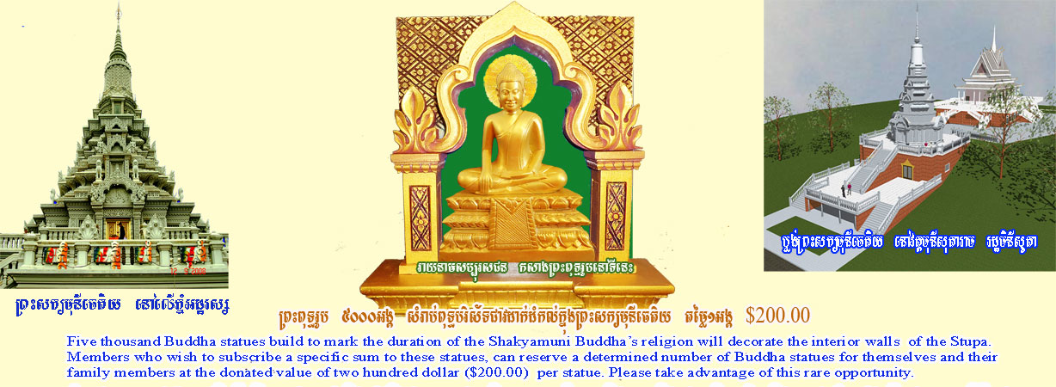
Only Connect!
Skills and Insights
For Bridging Client Differences
Diversity includes all the differences and similarities
that affect how we work and live together.
Sue Plaster Consulting
Building Bridges Across Differences
Minnesota Career Planning Association
April 20, 2012
Notes:
1

Slide 2
Our Objectives
Self-awareness: We will identify one or more key points of uniqueness or differentiation that we are conscious of when interacting with others.
Societal changes: We will very briefly highlight major demographic changes taking place around us and how they are affecting our daily encounters.
Skill-building. We will focus on six key skill areas that aid in communicating and building bonds with clients across differences.
Trial and Success:). We will explore some rapid means to try out our bond-building and connection approaches with one another.
Sue Plaster Consulting, March, 2012

Slide 3
About Our Workshop Title
“Only connect the prose and the passion, and both will be exalted, and human love will be seen at its highest. Live in fragments no longer” ― E.M. Forster
As adult learners, we are connecting the “prose and the passion” when we connect our life experiences with our professional and theoretical knowledge . . . and become more skilled.

Slide 4
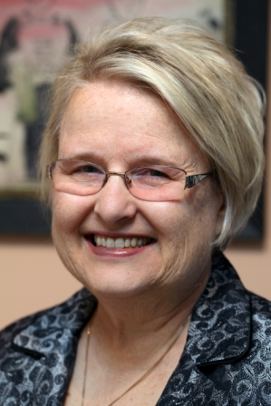

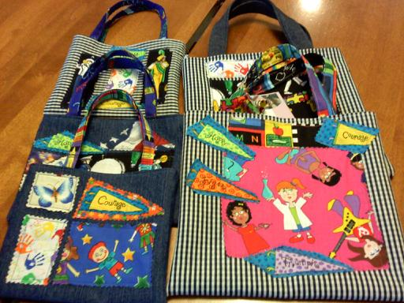
Power of Self-Awareness
Your Personal Haiku
Words that describe a factor of your uniqueness, grouped into meaningful phrases
Sequence: 1/2/3/4/5/4/3/2/1
Sue Plaster Consulting, March 2012

Slide 5

Sample Personal Haiku
Elders
In our
living room talked
About the old country and
“No Irish Need Apply.”
Now I am helping
People find jobs
In deep
Recession.
Sue Plaster Consulting, March 2012

Slide 6

From U.S. Census Data
Group | Population Size | Growth 2000-2010
Whites | 72% -- 223.6 mil. | Only Latino portion grew; white population down
Latinos | 16% -- 50.5 mil.
Blacks | 13% -- 38.9 mil. | 12%
Asian | 5% -- 14.5 mil. | 43%
Native American, Alaskan Native | 0.9% -- 2.9 mil. | 18%
Hawaiian/Other Pacific Islander | 0.2% -- 0.5 mil. | 33%
Some Other Race | 6% -- 19 mil.
So . . . Do You Know
What a Quinceanera is?
Sue Plaster Consulting, March, 2012

Slide 7
Families Are Changing Demographically
Younger household heads with significantly less wealth than elders (Pew Research Center 1984-2009)
Recession-related growth in multi-generation families (Record 16.7% of the population)
Family Dynamics
Economics
Ethnicity and Heritage
Language
More families where English is not primary home language (12% of U.S. population born in another country.)
More grandparents ethnically different from grandchildren
Sue Plaster Consulting, March 2012

Slide 8
Cornell University Disability Research
In the year 2010, an estimated 8.0 percent (plus or minus 0.2 percentage points) of civilian non-institutionalized, men and women, aged 18-64 in the United States reported a work limitation. In other words, 15,175,000 out of 189,692,000 (or about one in 13) civilian non-institutionalized, men and women, aged 18-64 in the United States reported a work limitation.
Note: Based on sample of 126,486 persons –
Current Population Survey (CPS).
Sue Plaster Consulting, March, 2012

Slide 9
About Minnesota – From U.S. Community Survey
60% Of MN Population of 5.3 million – Twin Cities.
40% -- Greater Minnesota
Over 75.0% of Minnesotans -- Western European descent -- German, Norwegian, Irish and Swedish.
In 2005–2007, 6.5% of Minnesotans were foreign-born, compared to 12.5% for U.S. The Latino population of Minnesota is increasing rapidly; other recent immigrants include Hmong, Somalis, other East Africans, Vietnamese, and those from the former Soviet bloc.
2007 -- 9.6% of Minnesotans five years and over spoke language other than English at home.
Sue Plaster Consulting, March, 2012

Slide 10

Examples of New Twin Cities Worship Sites Since 2000
Buddhist Temple -- Watt Munisotaram in Hampton, MN
New Hindu Temples in Maple Grove, Edina
Numerous new mosques in the Twin Cities, such as Abubacar As-Sadique in Minneapolis and Masjid Al-Tawba in Eden Prairie
New Sikh temple in Bloomington MN
So . . . Do You Know
What A Mandir Is?
Sue Plaster Consulting, March 2012
Notes:
A 2008 survey by the Pew Forum on Religion and Public Life found 32.0% of Minnesotans were affiliated with mainline Protestant traditions, 21.0% with Evangelical Protestant traditions, 28.0% with Roman Catholic traditions.
1.0% each were affiliated with Jewish, Islamic, Buddhist, and Black Protestant traditions.
Smaller amounts for other faiths.
13.0% unaffiliated.

Slide 11
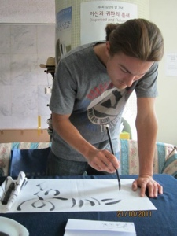
Potential For Five-Generation Workplace
Traditionals
Boomers
Generation X
Generation Y, or Millennials
Linksters
Key Idea: More important than the fact of multiple generations at work is the potential for significant differences among generations, due to technology, social, economic and other forces.
So . . . Do You Know
What “K” Means in a Text Message?
Sue Plaster Consulting, March 2012

Slide 12
Summary: Our Encounters Are Changing
Where we work
Where we live
Where we go to school
Where we shop
Where we express our faith
In our families
In Our Work,
How Can We Build Better Bonds
Across More Encounters of Difference?
Sue Plaster Consulting, March, 2012

Slide 13
First Level Encounter – Greeting
Name
Tone and Gesture
Listening Pattern
Greeting
Conflict Style
Eye Contact and Expressions
Sue Plaster Consulting, March 2012

Slide 14
Second Level Encounter – Connecting
Introverts/Extroverts
Collectivist/
Individualist
Achieved/Ascribed Respect
Direct/Indirect
Communicator
Sue Plaster Consulting, March 2012

Slide 15
Names
Susan Woulfe Plaster
Names are:
A tie to culture, spirituality, family ties, generation, values, etc.
A way to learn about what was given as well as what was lost or misunderstood
A generational marker
An opportunity for connection and bond
An opportunity for a respectful beginning
Sue Plaster Consulting, March 2012

Slide 16
Greetings Have Patterns Too
Important: In-group greeting pattern versus other-greeting pattern
Generational
Ethnicity
Language
Gender
Spirituality
More
Sue Plaster Consulting, March 2012

Slide 17
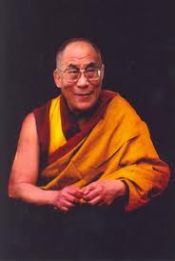
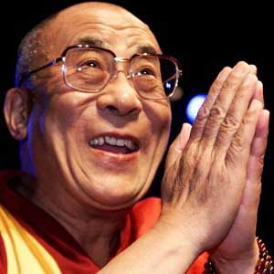
Eye Contact and Facial Expression
Sue Plaster Consulting, March 2012
Notes:
.

Slide 18
Tone and Gesture –
Essential in Successful Greeting
Acceptable Vocal Tone and Volume Vary Widely Among Cultural Groups
As Does Acceptable Body Space . . .
As Does Acceptable Gesture . . .
Safest Course:
Universal Open Gestures
Operating Assumptions
Conscious Mirroring
Sue Plaster Consulting, March 2012

Slide 19
Listening Patterns
Eye contact connected with listening or not
Separated, Sequential or Overlapping Speech
Interruption OK or not?
What is your
interpretation if I
disrupt your expected
listening pattern?
Sue Plaster Consulting, March 2012

Slide 20
Second Level Encounter – Connecting
Introverts/Extroverts
Collectivist/
Individualist
Achieved/Ascribed Respect
Direct/Indirect
Communicator
Sue Plaster Consulting, March 2012

Slide 21
For Stronger Encounters . . . And Connections
Names and greetings are a key. Learn five common men’s and women’s names for those you work with often.
2. Advance work on names and greetings will help you encounter new clients.
A “soft face” and open gestures may help when you are in doubt how to approach.
Work on trust building before or along with information gathering in cross-cultural situations.
If you disrupt a listening pattern, you may provoke a response, whether or not you can discern it.
If your conflict style is direct, realize the other person’s comfort style may be indirect. The reverse is true too.
Sue Plaster Consulting, March 2012

Slide 22
Closing Poem For You :)
Be
Yourself, with
All your gifts
And expertise. And be yourself
With your intercultural antennae fully extended outward.
You know
Plenty.
Sue Plaster Consulting, March 2012

Slide 23

Sue Plaster, M.Ed. -- Sue Plaster Consulting
plaster.sue@gmail.com. 612.723,4177
Building Bridges Across Differences
www.sueplasterconsulting.com
Sue Plaster has a broad career background in diversity and intercultural communications,
with more than 30 years experience leading, coaching and advising in organizations.
She works with individuals and organizations to address issues and opportunities
related to diversity and equity. Her work ranges from assessment and intervention
in workplace diversity issues to customer diversity. She also works with individual
clients on career development, mobility, and transition.
Sue served for more than 10 years as Director of Diversity for Fairview Health Services,
with responsibility for diversity and cultural competence policy, practice and education
in the 22,000-employee health system. Before joining Fairview, Sue was Director
of Leadership, Mobility, and Succession Planning for Honeywell Inc. At Honeywell she
also held leadership positions in Corporate Promotion and Worldwide Employee
Communications. Prior to that, Sue was a communications manager for a medical device
Firm and a high school instructor. Sue taught in the Master’s in Business Communication
Program at University of St. Thomas and frequently presents for the Twin Cities
Multicultural Forum for Workplace Diversity.

